Slide 1
Simulation of Electron Drift Properties and Track Reconstruction for the Deep Underground Neutrino Experiment
Honors Thesis Presented by Aaron Mutchler
Advised by Professor Alysia Marino
March 23, 2021
Notes:
Hello everyone!
and welcome to my honors thesis defense on simulation of electron drift properties and track reconstruction for the deep underground neutrino experiment

Slide 2
Overview
Neutrinos
DUNE
Particle detection
Implementation at DUNE
Event displays
PyBoltz
Drift properties: detector tolerance
GArSoft
Diffusion impact on reconstruction efficiency
Summary and next steps
Notes:
What they are and why study them
who’s studying them
How neutrinos are detected
How will this be implemented at DUNE
What some interaction events may look like
And then i will transition to my studies on electron drift properties followed by
my studies on track reconstruction efficiency and then I will
end with summary and conclusions

Slide 3
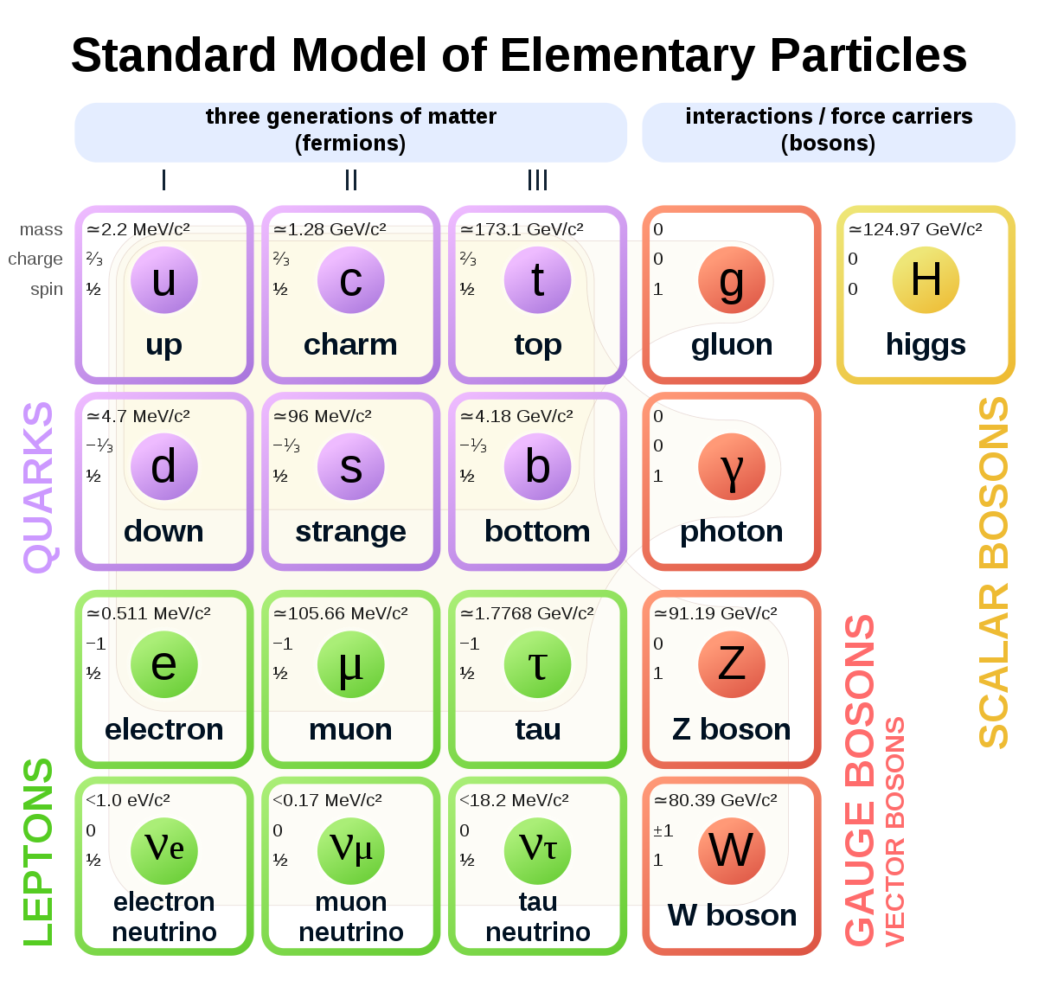
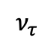
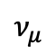
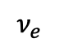
Neutrinos
Neutrinos are fundamental particles that come in three flavors: electron, muon, and tau.
Unlike other matter particles in the Standard Model, they are electrically neutral and have almost no mass.
They can change their flavor: oscillate.
When the Standard Model was created neutrinos were thought to be massless. Oscillations can only occur with distinct masses; therefore, they are not massless.
$$ν_{e}$$
$$ν_{μ}$$
$$ν_{τ}$$
Distance/Energy
Just an example oscillation*
Notes:
Therefore the neutrinos cannot be massless. Let’s see why this is so…

Slide 4
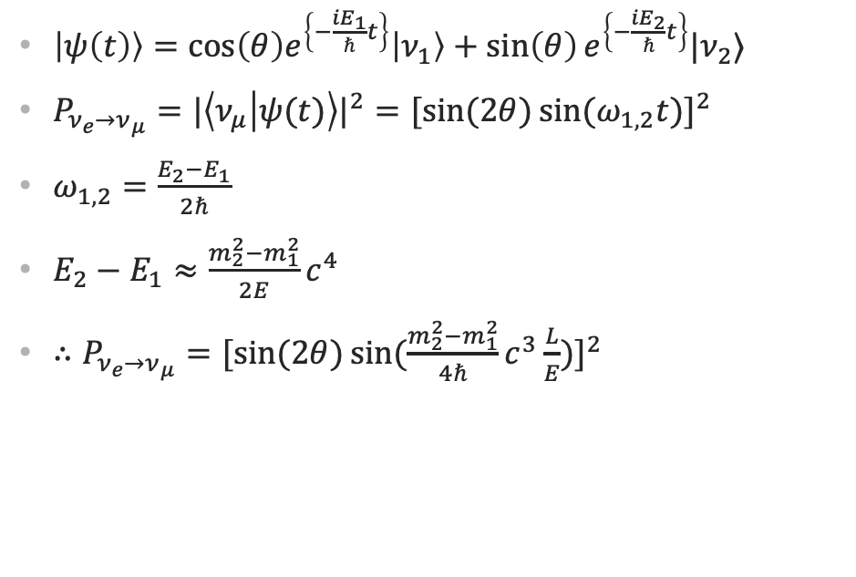
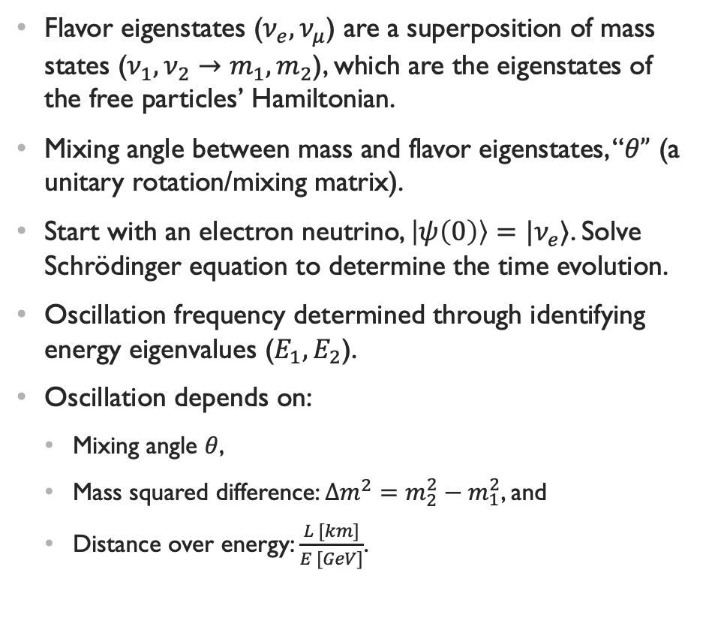
Neutrino Oscillations (2 Flavors)
Flavor eigenstates ($ν_{e},ν_{μ}$) are a superposition of mass states ($ν_{1},ν_{2}→m_{1},m_{2}$), which are the eigenstates of the free particles’ Hamiltonian.
Mixing angle between mass and flavor eigenstates, “$θ”$ (a unitary rotation/mixing matrix).
Start with an electron neutrino, $\left|ψ\left(0\right)\right\rangle =|ν_{e}⟩$. Solve Schrödinger equation to determine the time evolution.
Oscillation frequency determined through identifying energy eigenvalues ($E_{1},E_{2}$).
Oscillation depends on:
Mixing angle $θ$,
Mass squared difference: $Δm^{2}=m_{2}^{2}−m_{1}^{2}$, and
Distance over energy: $\frac{L [km]}{E [GeV]}$.
$\left|ψ\left(t\right)\right\rangle =cos\left(θ\right)e^{\left\{−\frac{iE_{1}}{ℏ}t\right\}}\left|ν_{1}\right\rangle +\sin\left(θ\right)e^{\left\{−\frac{iE_{2}}{ℏ}t\right\}}|ν_{2}⟩$
$P_{ν_{e}→ν_{μ}}={|\left\langle ν_{μ} | ψ(t)\right\rangle |}^{2}={[\sin{(2θ)}\sin{(ω_{1,2}t)}]}^{2}$
$ω_{1,2}=\frac{E_{2}−E_{1}}{2ℏ}$
$E_{2}−E_{1}≈\frac{m_{2}^{2}−m_{1}^{2}}{2E}c^{4}$
$∴P_{ν_{e}→ν_{μ}}=$ ${[\sin{(2θ)}\sin{(\frac{m_{2}^{2}−m_{1}^{2}}{4ℏ}c^{3}\frac{L}{E})}]}^{2}$
Notes:
To simply the math I will start with a discussion of oscillations when there are only 2 flavors say electron and muon neutrinos.
Oscillation is given by the quantum mechanical mixing of states
This is just a simplified case, what happens when we add in the other flavor
E_i≈pc+〖〖(m〗_i c^2)〗^2/2pc now using mc^2≪pc, p=E/c, t≈L/c
L=2πℏE/((m_2^2-m_1^2 ) c^3 )

Slide 5
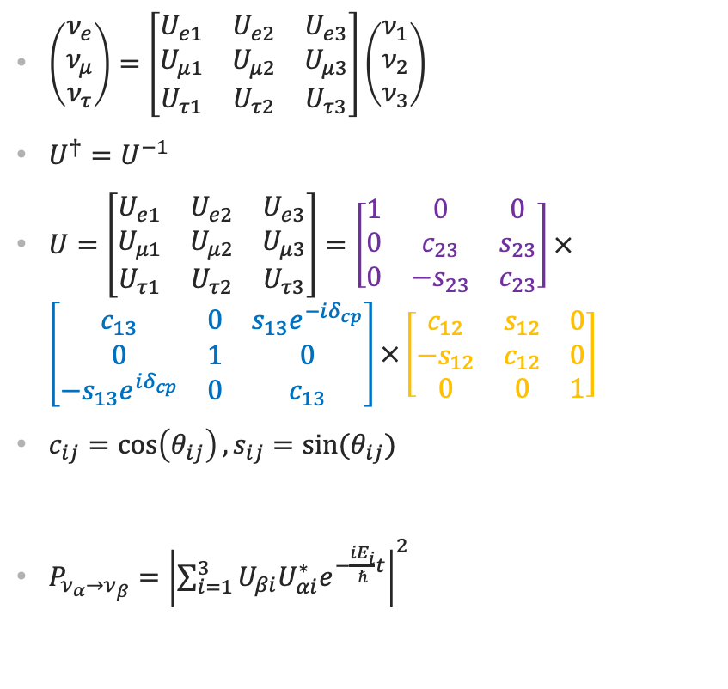
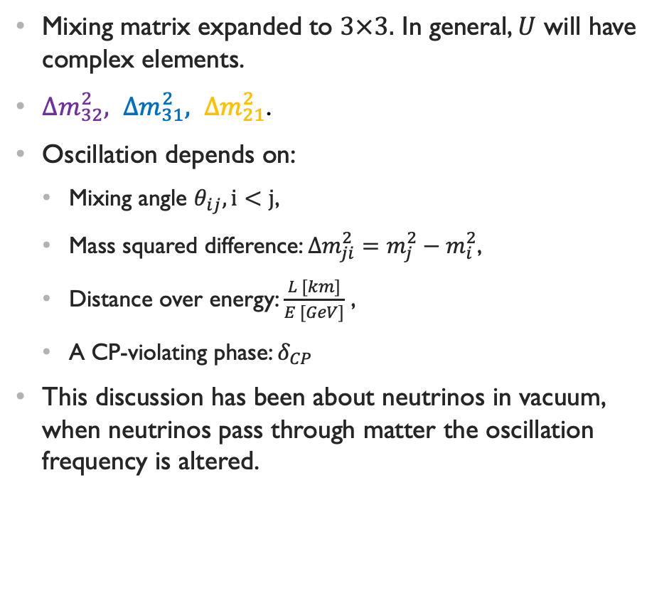
Neutrino Oscillations (3 Flavors)
Mixing matrix expanded to $3×3.$ In general, $U$ will have complex elements.
$Δm_{32}^{2}, Δm_{31}^{2}, Δm_{21}^{2}$.
Oscillation depends on:
Mixing angle $θ_{ij}, i<j$,
Mass squared difference: $Δm_{ji}^{2}=m_{j}^{2}−m_{i}^{2}$,
Distance over energy: $\frac{L [km]}{E [GeV]}$ ,
A CP-violating phase: $δ_{CP}$
This discussion has been about neutrinos in vacuum, when neutrinos pass through matter the oscillation frequency is altered.
$\left(\begin{matrix}ν_{e} \\ ν_{μ} \\ ν_{τ}\end{matrix}\right)=\left[\begin{matrix}U_{e1} & U_{e2} & U_{e3} \\ U_{μ1} & U_{μ2} & U_{μ3} \\ U_{τ1} & U_{τ2} & U_{τ3}\end{matrix}\right]\left(\begin{matrix}ν_{1} \\ ν_{2} \\ ν_{3}\end{matrix}\right)$
$U^{†}=U^{−1}$
$U=\left[\begin{matrix}U_{e1} & U_{e2} & U_{e3} \\ U_{μ1} & U_{μ2} & U_{μ3} \\ U_{τ1} & U_{τ2} & U_{τ3}\end{matrix}\right]=\left[\begin{matrix}1 & 0 & 0 \\ 0 & c_{23} & s_{23} \\ 0 & −s_{23} & c_{23}\end{matrix}\right]×\left[\begin{matrix}c_{13} & 0 & s_{13}e^{−iδ_{cp}} \\ 0 & 1 & 0 \\ −s_{13}e^{iδ_{cp}} & 0 & c_{13}\end{matrix}\right]×\left[\begin{matrix}c_{12} & s_{12} & 0 \\ −s_{12} & c_{12} & 0 \\ 0 & 0 & 1\end{matrix}\right]$
$c_{ij}=\cos\left(θ_{ij}\right), s_{ij}=sin⁡(θ_{ij})$
$P_{ν_{α}→ν_{β}}={\left|\sum_{i=1}^{3}{U_{βi}U_{αi}^{∗}e^{−\frac{iE_{i}}{ℏ}t}}\right|}^{2}$
Notes:
Can break U up into components dependent on each separate mixing angle, \theta_i j
This alteration comes from electron neutrino – electron scattering
Gives an extra factor dependent on the mass splitting \delta m_ij ^2.
I will talk more about this mass splittiling but first here is a visual for oscillation probabilities

Slide 6
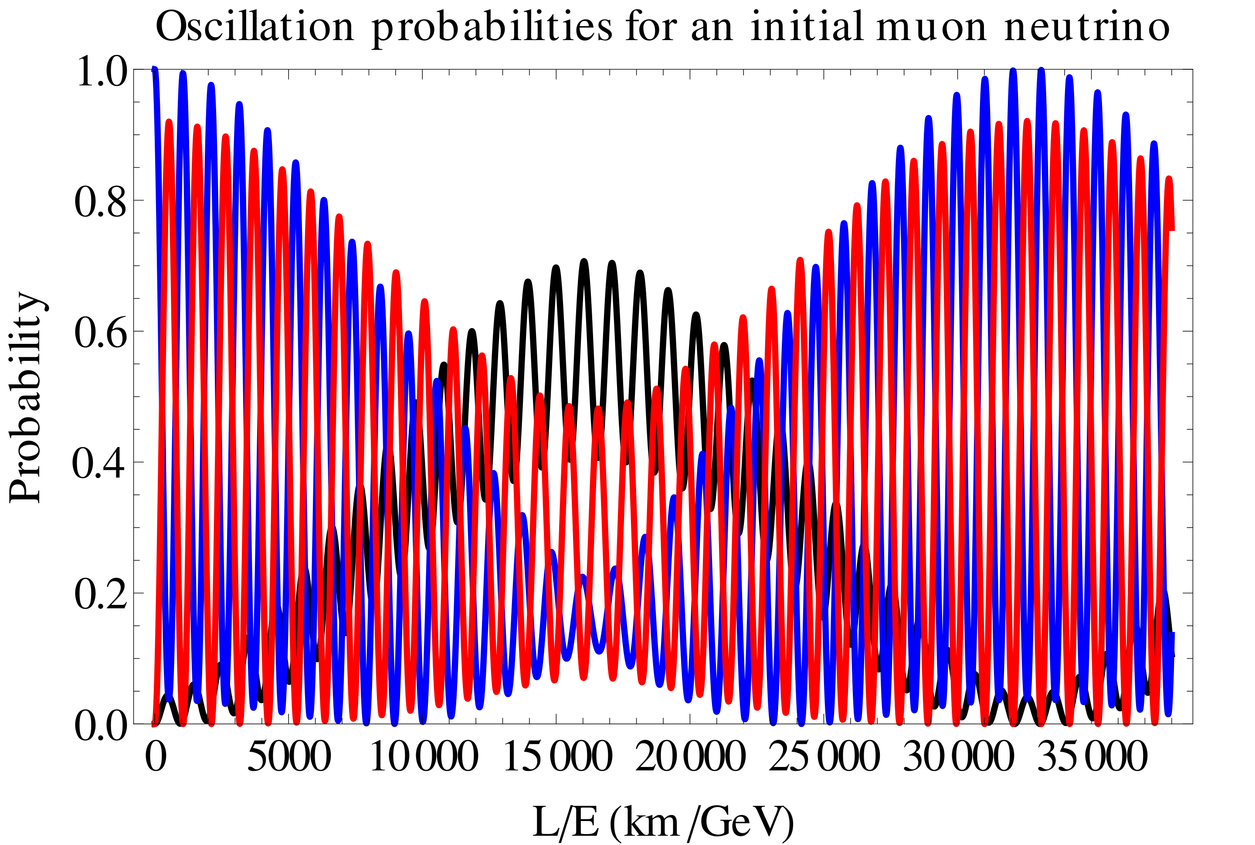
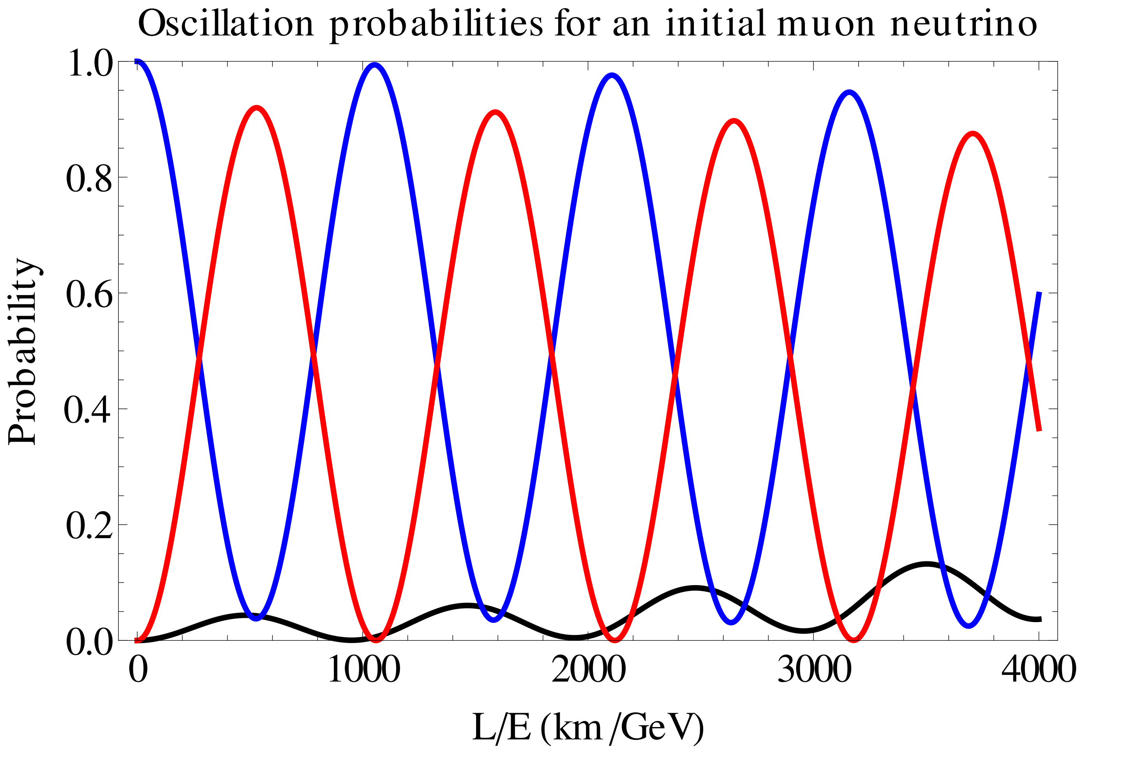
Oscillation Probabilities
Muon neutrino
Electron neutrino
tau neutrino
Notes:
Now back to the mass splitting

Slide 7
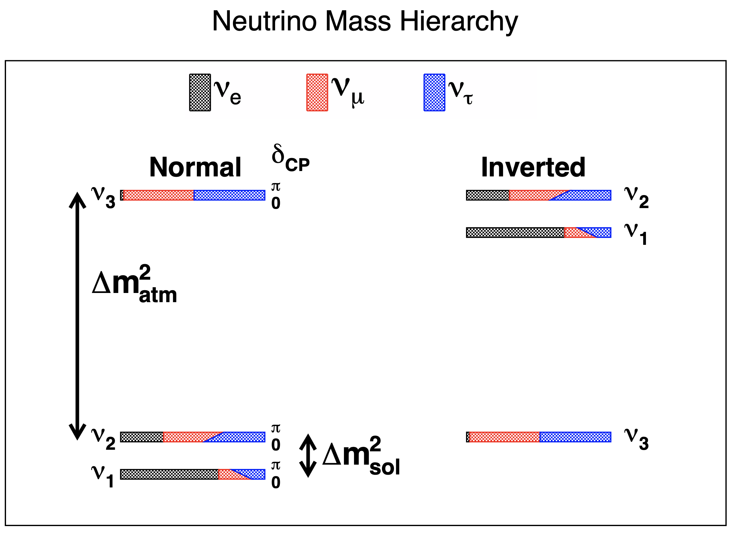
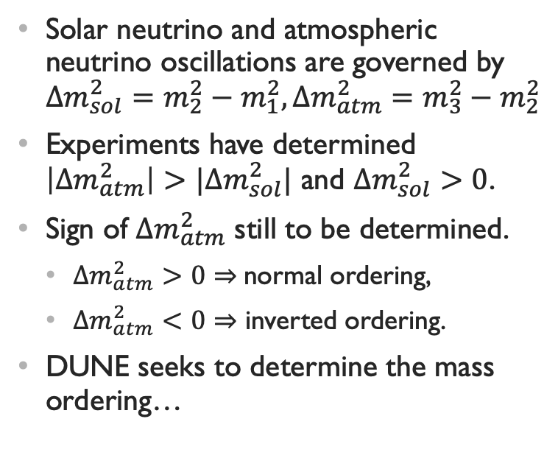
Mass Ordering
Solar neutrino and atmospheric neutrino oscillations are governed by $Δm_{sol}^{2}=m_{2}^{2}−m_{1}^{2}, Δm_{atm}^{2}=m_{3}^{2}−m_{2}^{2}$
Experiments have determined $\left|Δm_{atm}^{2}\right|>|Δm_{sol}^{2}|$ and $Δm_{sol}^{2}>0$.
Sign of $Δm_{atm}^{2}$ still to be determined.
$Δm_{atm}^{2}>0⇒$normal ordering,
$Δm_{atm}^{2}<0⇒$ inverted ordering.
DUNE seeks to determine the mass ordering…
Notes:
We would like to know the ordering of the neutrino mass states. However we can only measure the difference of squared masses from oscillations.
Some work to determine this has been done already from solor and atmospheric neutrino experiments
As I previously said matter effects gives an extra factor dependent on the mass splitting \delta m_ij ^2 which will alter neutrino oscillations and this provides a window into determing if the mass ordering is normal or inverted.
Experiments like DUNE can measure this effect on neutrino and anti-neutrino oscillations

Slide 8
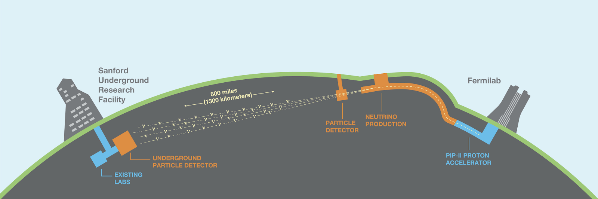
Deep Underground Neutrino Experiment
Primary Goal:
Understand the role of neutrinos in the universe and matter-antimatter asymmetry through the study of neutrino oscillations.
Notes:
Where it will seek to determine the mass ordering, and understand the role of neutrinos in the universe and matte-antimatter asymmetry through the study of neutrino oscillations.
This is a graphic of DUNE's beamline...
The neutrino's flavor needs to be measured how is this done?

Slide 9
Detection of Neutrinos
Notes:
well neutrinos are, as i previosly mentioned, electrically neutral and have almost no mass so how do we detect them...

Slide 10
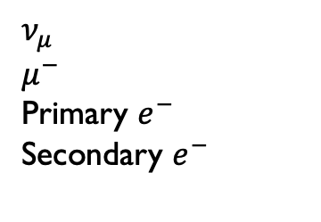
TPC Particle Detection
$$ν_{μ}$$
$$μ^{−}$$
Primary $e^{−}$
Secondary $e^{−}$
Field cage
B-Field:
Electrons will drift at a constant velocity (until the readout plane)
This allows us to use the timing to determine how far the particle drifted.
E-Field:
E-Field:
Readout plane
High Voltage Central Cathode
Readout plane

Slide 11
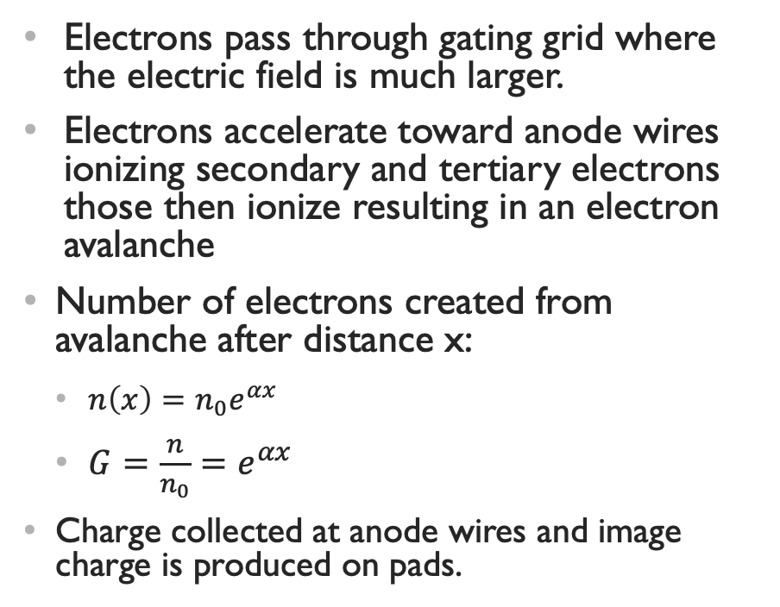
Reaching the Readout Plane
Electrons pass through gating grid where the electric field is much larger.
Electrons accelerate toward anode wires ionizing secondary and tertiary electrons those then ionize resulting in an electron avalanche
Number of electrons created from avalanche after distance x:
$n\left(x\right)=n_{0}e^{αx}$
$G=\frac{n}{n_{0}}=e^{αx}$
Charge collected at anode wires and image charge is produced on pads.
Gating grid
Anode wires
Pads

Slide 12
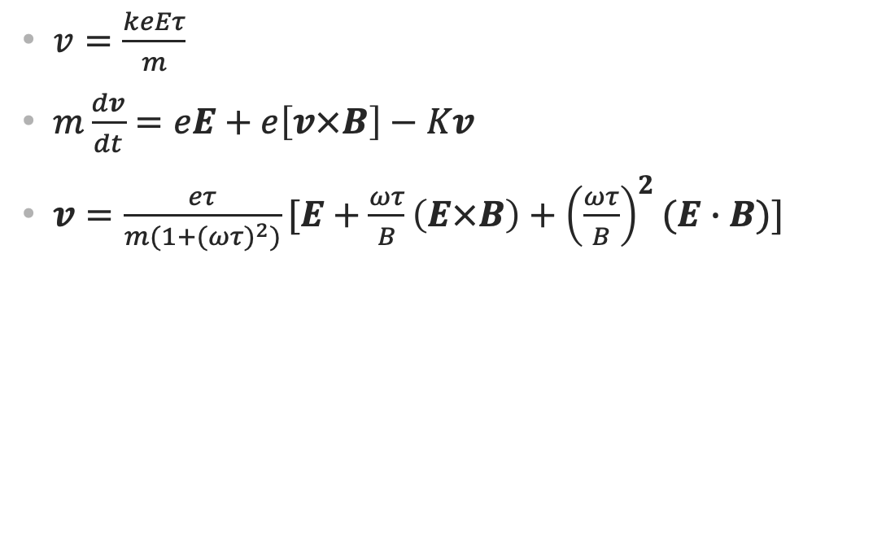
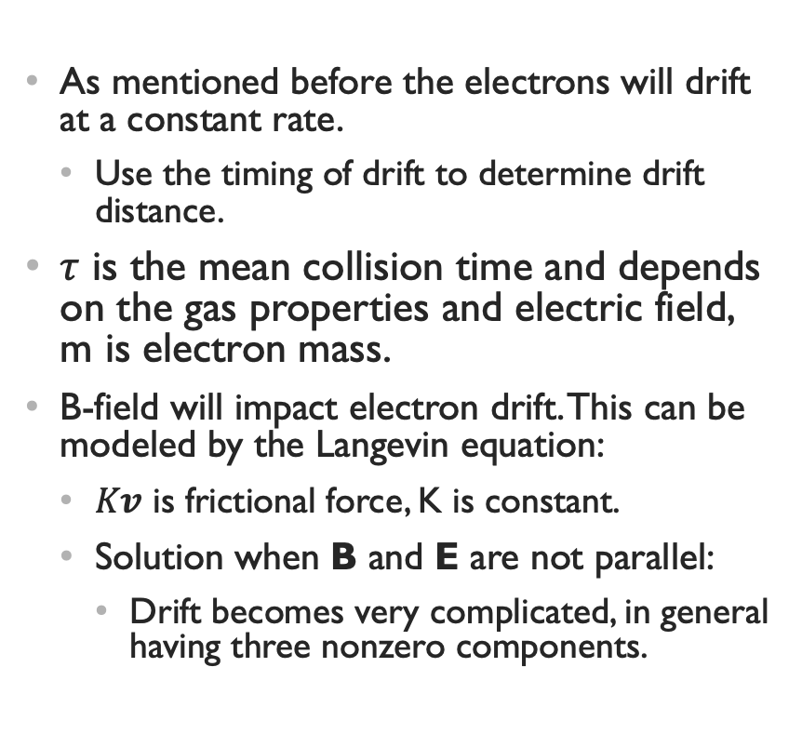
Electron Drift
As mentioned before the electrons will drift at a constant rate.
Use the timing of drift to determine drift distance.
$τ$ is the mean collision time and depends on the gas properties and electric field, m is electron mass.
B-field will impact electron drift. This can be modeled by the Langevin equation:
$Kv$ is frictional force, K is constant.
Solution when B and E are not parallel:
Drift becomes very complicated, in general having three nonzero components.
$v=\frac{keEτ}{m}$
$m\frac{dv}{dt}=eE+e\left[v×B\right]−Kv$
$v=\frac{eτ}{m(1+({ωτ)}^{2})}[E+\frac{ωτ}{B}\left(E×B\right)+{\left(\frac{ωτ}{B}\right)}^{2}(E∙B)]$
Notes:
Langevin equation gives drift velocity of electrons in the prescene of a b-field

Slide 13
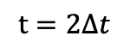
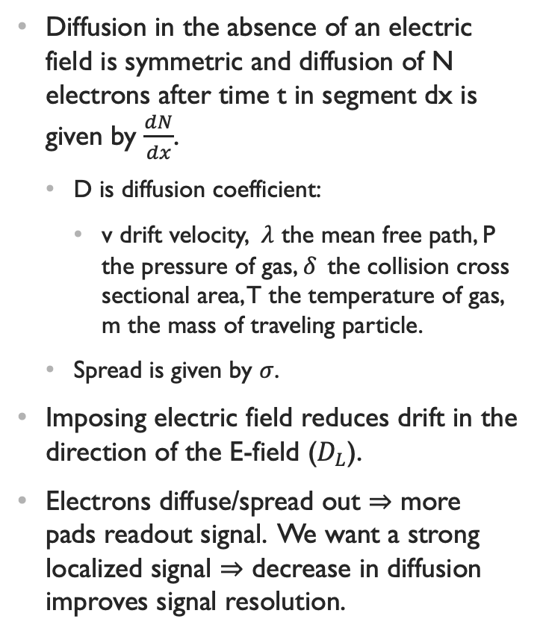
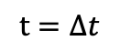
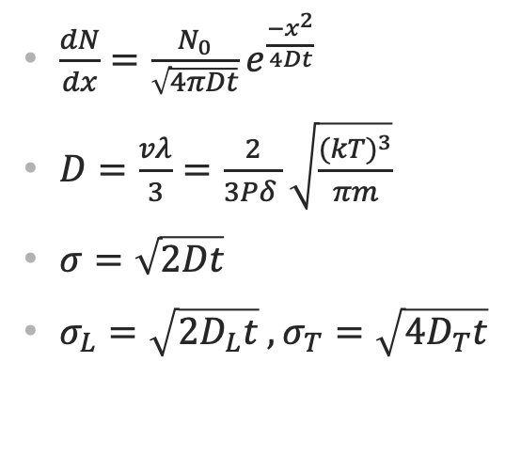
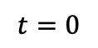
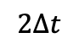
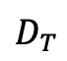
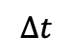
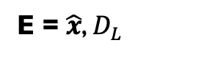
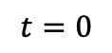
Electron Diffusion
Diffusion in the absence of an electric field is symmetric and diffusion of N electrons after time t in segment dx is given by $\frac{dN}{dx}$.
D is diffusion coefficient:
v drift velocity, $λ$ the mean free path, P the pressure of gas, $δ_{ }$ the collision cross sectional area, T the temperature of gas, m the mass of traveling particle.
Spread is given by $σ$.
Imposing electric field reduces drift in the direction of the E-field ($D_{L}$).
Electrons diffuse/spread out $⇒$ more pads readout signal. We want a strong localized signal $⇒$ decrease in diffusion improves signal resolution.
$\frac{dN}{dx}=\frac{N_{0}}{\sqrt{4πDt}}e^{\frac{{−x}^{2}}{4Dt}}$
$D=\frac{vλ}{3}=\frac{2}{3Pδ_{ }}\sqrt{\frac{{(kT)}^{3}}{πm}}$
$σ=\sqrt{2Dt}$
$σ_{L}=\sqrt{2D_{L}t} , σ_{T}=\sqrt{4D_{T}t}$
No E-Field:
$$t=Δt$$
$$t=2Δt$$
$$t=0$$
E-Field:
$$t=0$$
$$Δt$$
$$2Δt$$
$$D_{T}$$
time
E = $\hat{x}$, $D_{L}$

Slide 14
Implementation at DUNE

Slide 15
Near Detector Hall
ECAL
ND-GAr
Magnet coil
DUNE near detector hall (left).
Neutrinos pass through liquid argon detector (ND-LAr) then through ND-GAr.
ND-GAr (above).
Superconducting magnet coil
Electromagnetic calorimeter (ECAL), catch $e^{+},e^{−},γ^{′}s$
High Pressure gaseous argon Time Projection Chamber (HPgTPC).
HPgTPC
ND-GAr
ND-LAr
$ν−$beam
Note SAND detector not pictured

Slide 16
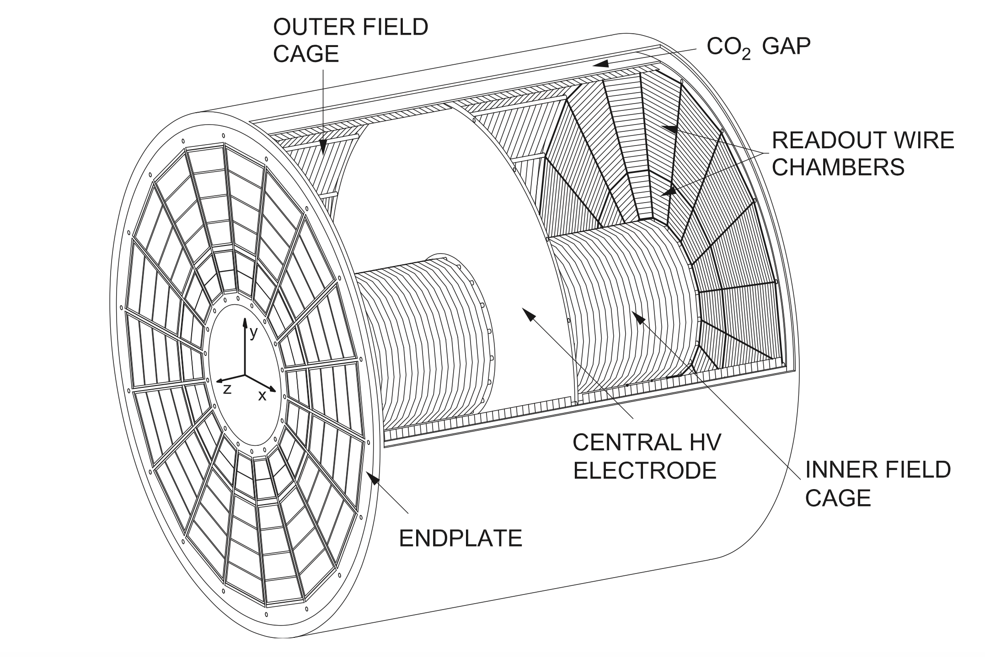
HPgTPC
Design of HPgTPC based on TPC for the ALICE experiment at CERN
Will be filled with 90% argon and 10% methane
High resolution momentum measurement of particles exiting ND-LAr
Will resolve neutrino interactions on argon gas with high resolution and low momentum thresholds
~2.5 m
ALICE TPC from CERN
~5 m

Slide 17
Event Displays

Slide 18
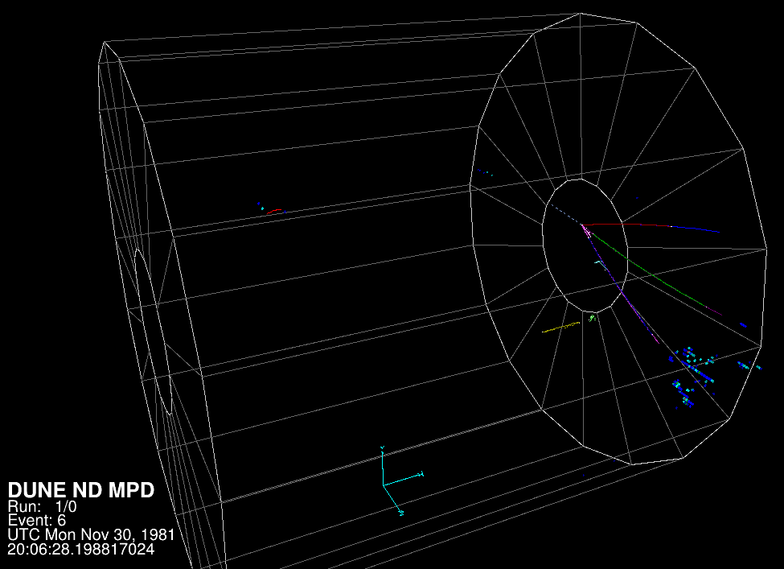
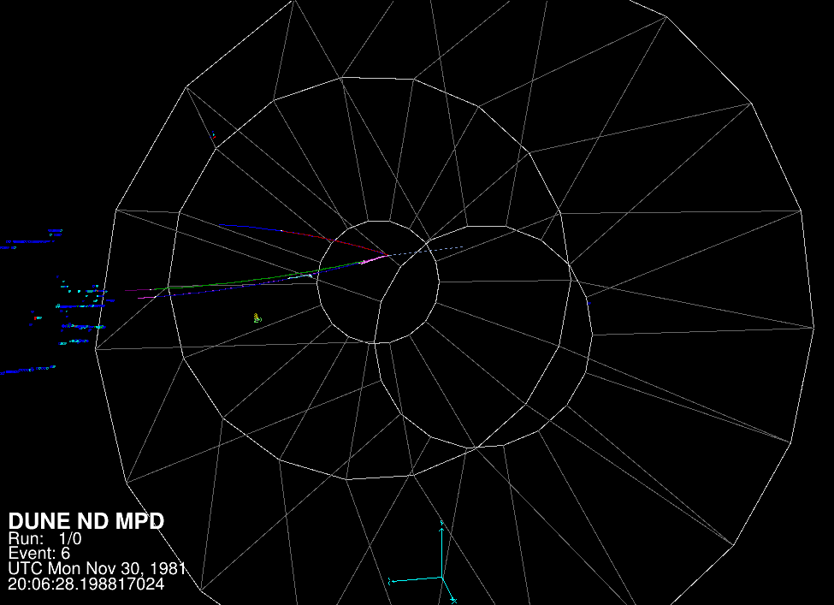
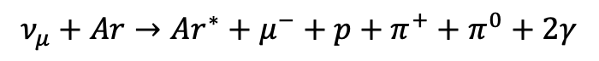
Neutrino Event Display
$$ν_{μ}+Ar→Ar^{∗}+μ^{−}+p+π^{+}+π^{0}+2γ$$
Muon neutrino
Muon
Proton
Pions ($π^{+}, π^{0}$)
Gammas
Electrons
ECAL shower

Slide 19
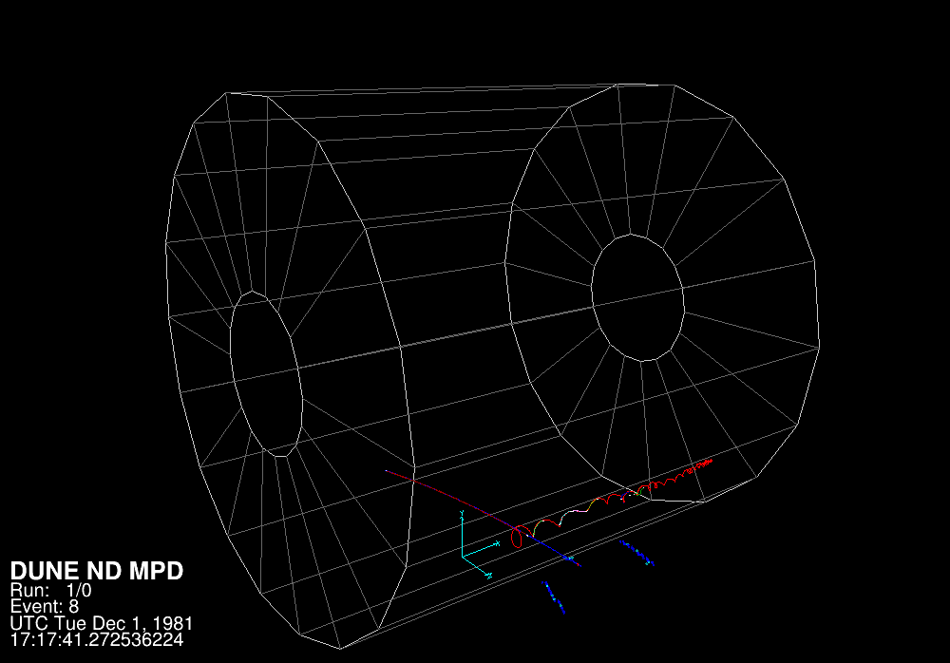
Muon Event Display
Initial muon (red) with 1.941 GeV
Curve in magnetic field
Kicks out low energy electrons, which drift to the readout plane (red spiral).
ECAL shower (blue)

Slide 20
PyBoltz
New Monte-Carlo Python Package.
Use simulation to determine:
Drift velocity and error
Transverse diffusion and error
Longitudinal diffusion and error
Attachment rate and error
Ionization rate and error
Mean collision time
Al Atoum, B., Biagi, S. F., González-Díaz, D., Jones, B. J. P., & McDonald, A. D. (2020). Electron transport in gaseous detectors with a Python-based Monte Carlo simulation code. Computer Physics Communications, 107357.

Slide 21
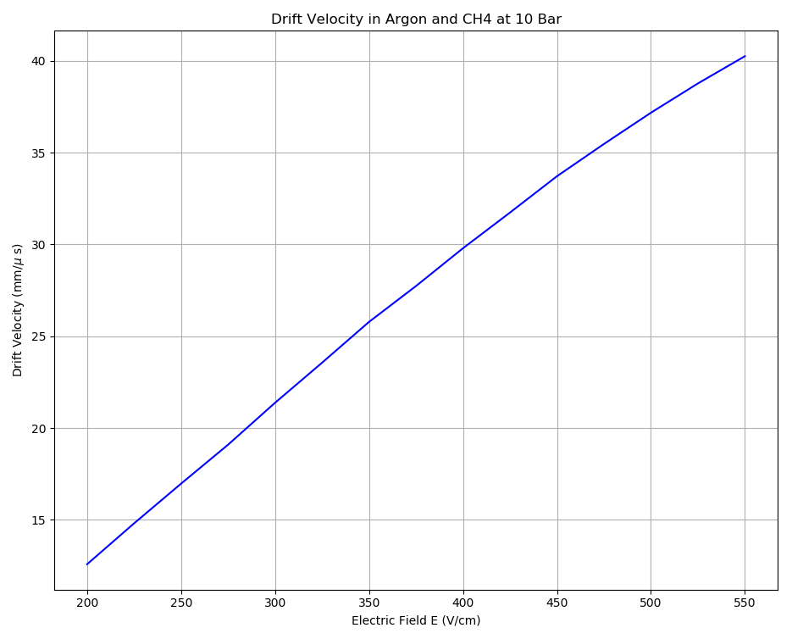
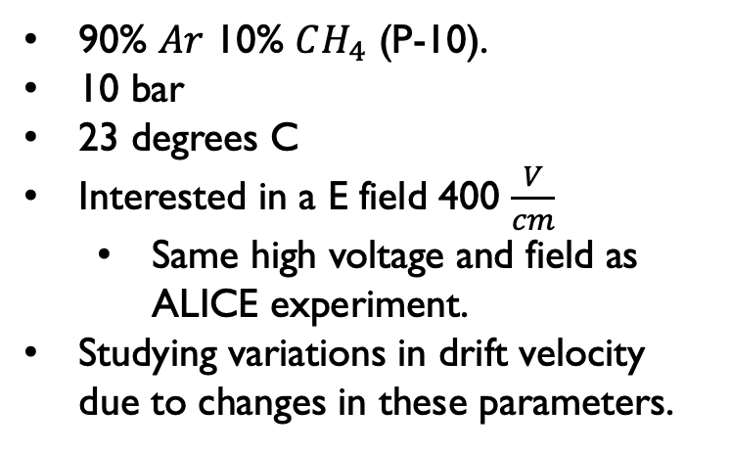
Assumptions and conditions
90% $Ar$ 10% $CH_{4}$ (P-10).
10 bar
23 degrees C
Interested in a E field 400 $\frac{V}{cm}$
Same high voltage and field as ALICE experiment.
Studying variations in drift velocity due to changes in these parameters.
$$v_{drift}≈30\frac{mm}{μs}$$
Applied E-Field to HPgTPC

Slide 22
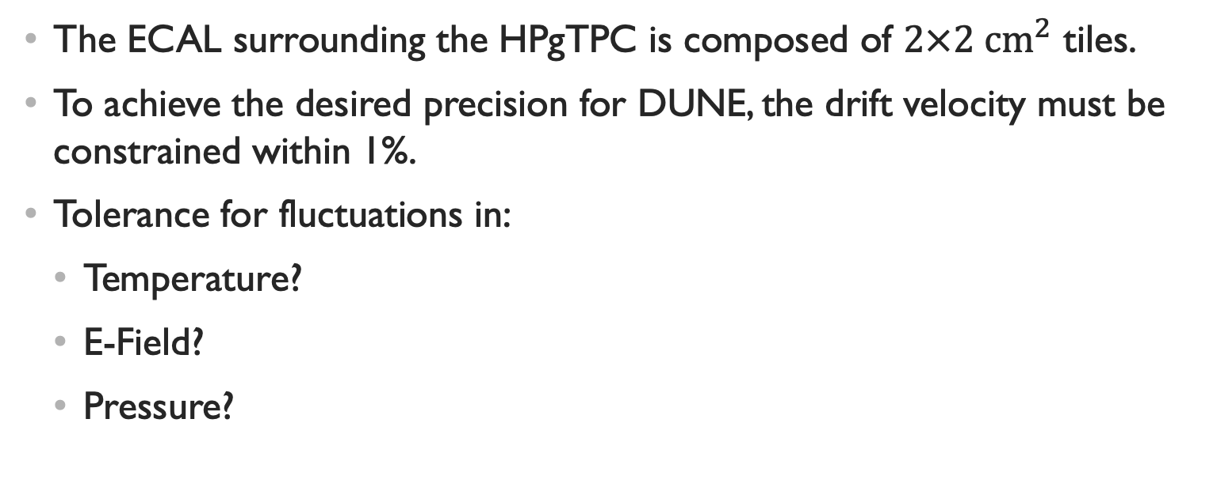
What Do We Want To Know?
The ECAL surrounding the HPgTPC is composed of $2×2 {cm}^{2}$ tiles.
To achieve the desired precision for DUNE, the drift velocity must be constrained within 1%.
Tolerance for fluctuations in:
Temperature?
E-Field?
Pressure?

Slide 23
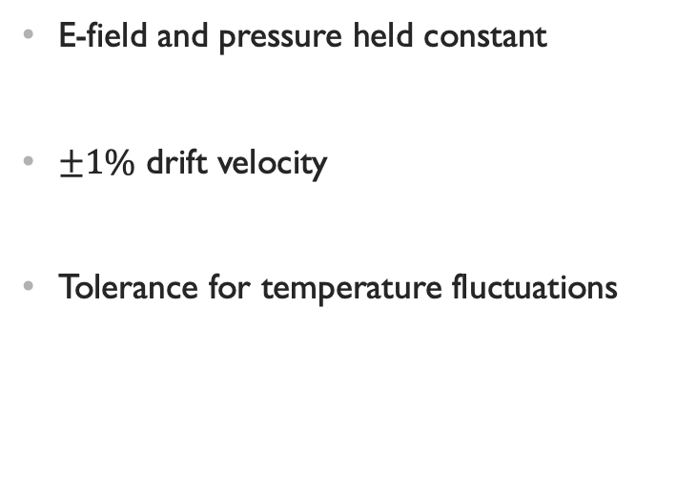
Temperature Bounds
E-field and pressure held constant
$±1\%$ drift velocity
Tolerance for temperature fluctuations

Slide 24
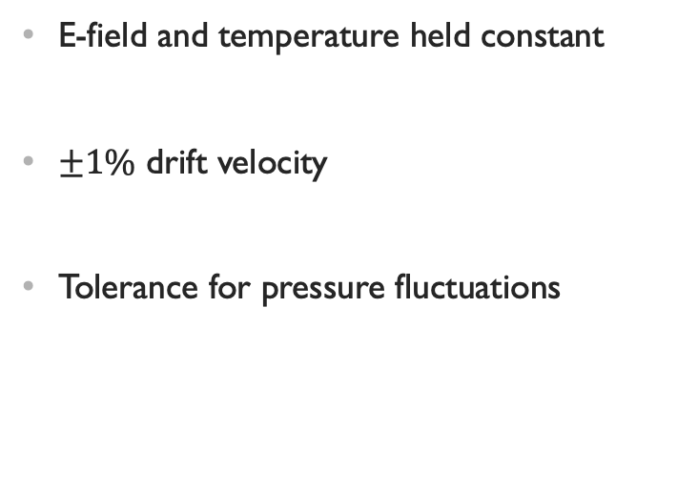
Pressure Bounds
E-field and temperature held constant
$±1\%$ drift velocity
Tolerance for pressure fluctuations

Slide 25
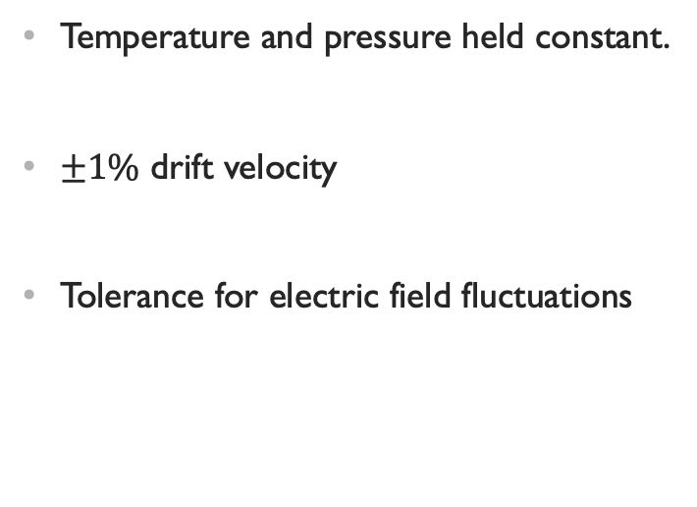
Electric Field Bounds
Temperature and pressure held constant.
$±1\%$ drift velocity
Tolerance for electric field fluctuations

Slide 26
Track Reconstruction Efficiency

Slide 27
GArSoft
Software to simulate tracks in the HPgTPC and performs track reconstruction.
The focus here will be on the impact of increased diffusion on track reconstruction efficiency.
Aside from the nominal case 2, 4, 10, and 20 times the diffusion constants (both longitudinal and transverse) were investigated.
HPgTPC gas medium and parameters are not yet official. How much diffusion can the reconstruction handle?
Plotted also are the simulated track starting positions in the YZ and XY planes next to the reconstructed track starting positions.

Slide 28
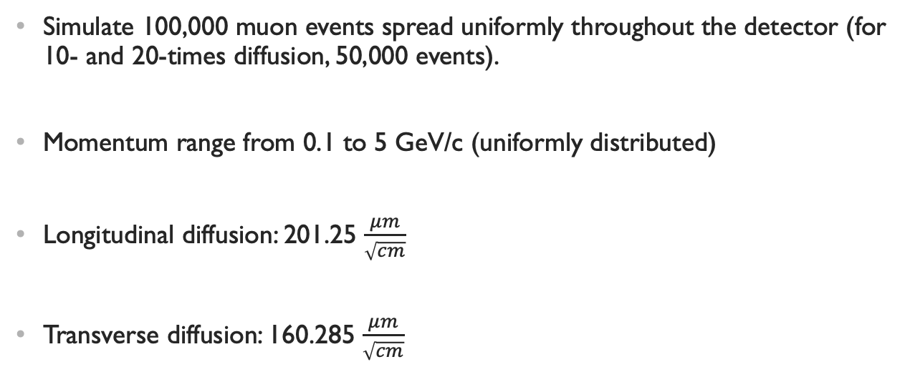
GArSoft: The Nominal Case
Simulate 100,000 muon events spread uniformly throughout the detector (for 10- and 20-times diffusion, 50,000 events).
Momentum range from 0.1 to 5 GeV/c (uniformly distributed)
Longitudinal diffusion: 201.25 $\frac{μm}{\sqrt{cm}}$
Transverse diffusion: 160.285 $\frac{μm}{\sqrt{cm}}$

Slide 29
Nominal case
Monte Carlo simulated start positions on bottom
Reconstructed track position on top

Slide 30
Nominal
Of the reconstructed tracks, I only select those within 5 cm of the MC simulated track.
Of those, pick the closest to simulated track: this is a matched track and select the associated MC track.
Divide the number of matched tracks by the number of simulated tracks in a given bin.
This looks good; the tracks have been successfully reconstructed.
Drop at large z due to short tracks

Slide 31
Nominal Momentum Efficiency
Lower momentum, worse efficiency.
[GeV/c]

Slide 32
Twice Diffusion constants
Not a significant change

Slide 33
4x Diffusion Constants
Impact starts to become clearer.
About 5% loss in x
This drop in x makes sense:
The more electrons spread out the more pads on the readout plane are triggered and the signal resolution is lowered

Slide 34
10x
Effect becoming much clearer.
Dropping about 10% at worst.

Slide 35
20x
Dramatic change and loss in efficiency
About 35% loss in x
10-20% loss in y and z

Slide 36
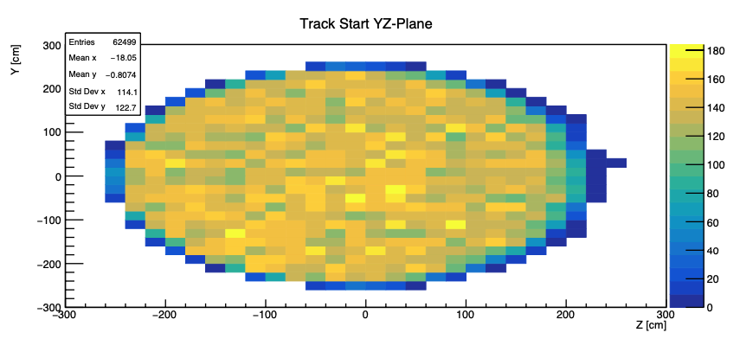
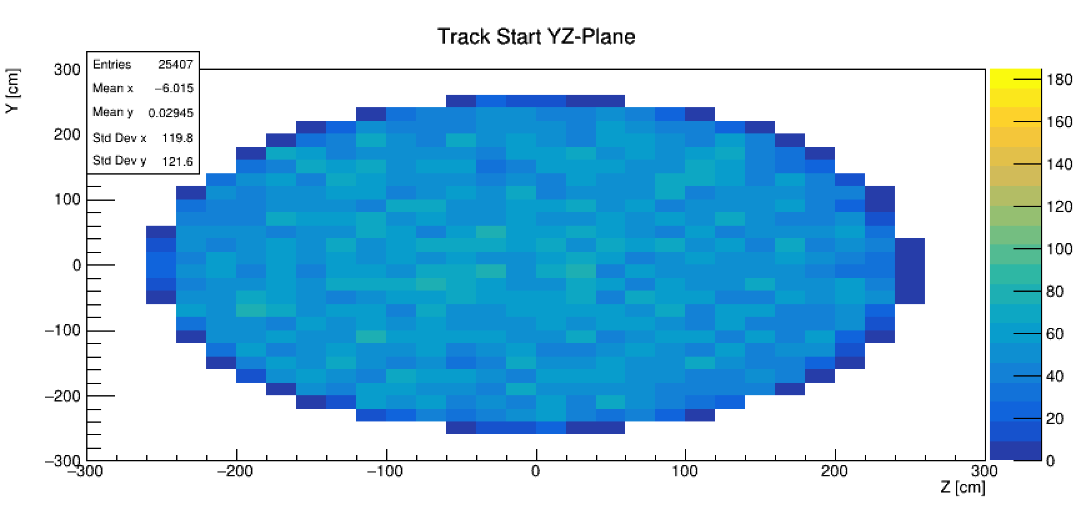
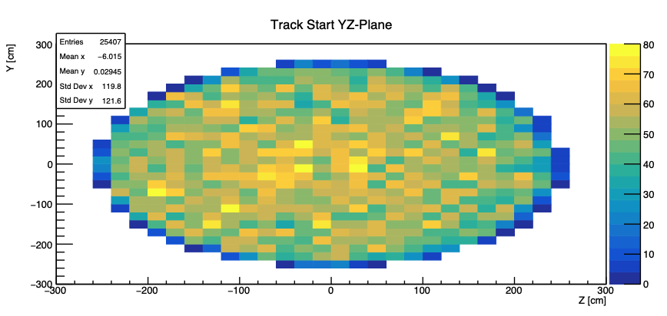
Nominal
To help show the loss in reconstruction ability between nominal (right) and 20 times the diffusion constants (below).
20x

Slide 37
Summary and Conclusions
To maintain a 1% variation in drift velocity:
Temperature must be held stable +/- 2 degrees Celsius,
E-Field must be held stable +/- 4 V/cm, and
Pressure must be held stable +/- 0.1 bar.
Can safely reconstruct tracks with a diffusion factor of 2 or 4 larger than the nominal case, but performance degrades above this.

Slide 38
Future Work
Simulation of electron drift properties in a magnetic field that is not parallel to the electric field.
A more comprehensive look at track reconstruction efficiency including:
Altering the drift velocity with the diffusion, and
Understanding the impact of electron loss.

Slide 39


Thank you

Slide 40
Extra

Slide 41
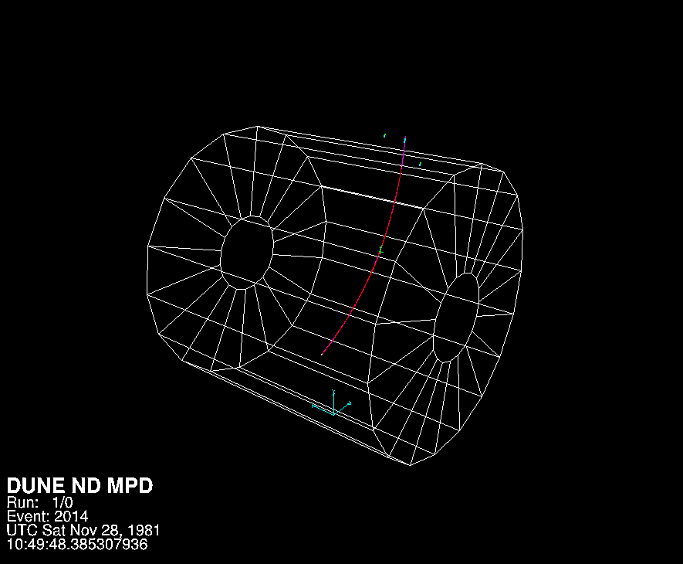
Proton Event Display
Initial proton (red) with 1.236 GeV
Curve in magnetic field:
Proton travelling in $\hat{z}$, E-field and B-field in $±\hat{x}$
Kick out electrons (green)
y
z
x

Slide 42
Electro-Negativity
When contaminants like $O_{2}, H_{2}O, and Cl$are introduced into the gas mixture there is a non-zero probability that the drifting electrons attach to these electro-negative elements and compounds.
When a liberated electron reattaches, we lose the signal and information that came with it.
Even a few parts per million of electro-negative gas can kill off the entire signal... (see next slide)

Slide 43
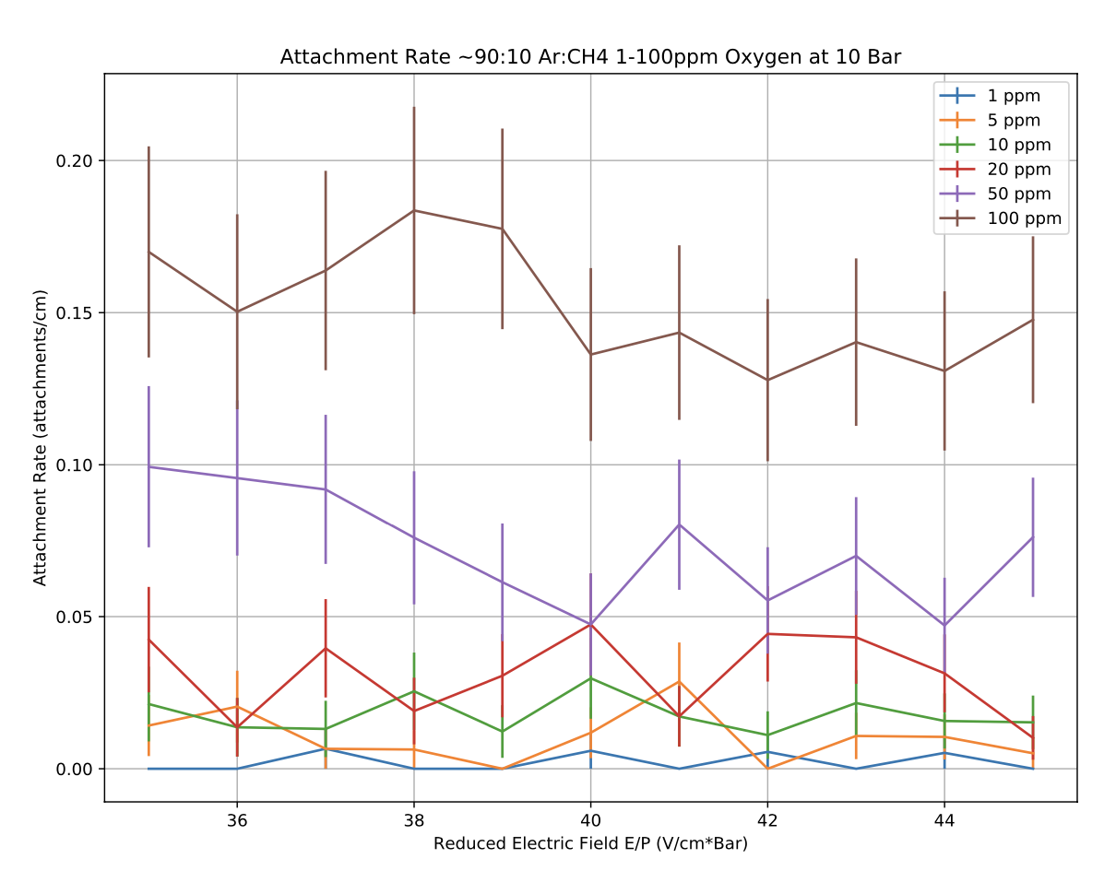
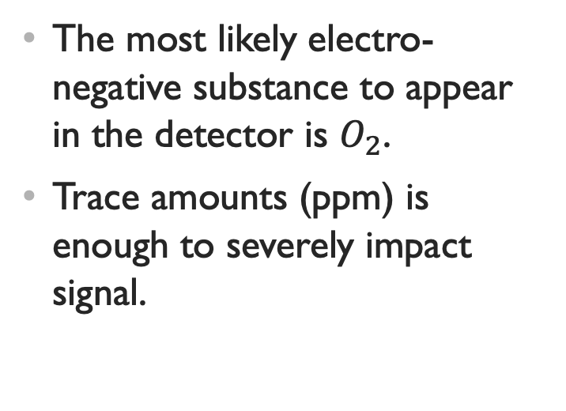
Electron Attachment to Oxygen
The most likely electro-negative substance to appear in the detector is $O_{2}$.
Trace amounts (ppm) is enough to severely impact signal.

